Slide 1
Donald A Macleod & Steven Graham e-Sgoil
Notes:
MM

Slide 2
National e-Learning Offer:
Early Years
BGE Primary
BGE Secondary
Senior Phase
Study Support webinars
DYW Live
Lockdown Live
Gaidhlig Bheo
Core business:
Supply cover for schools
i-Sgoil
Broadening the curricular offer
GME
Headlines
Notes:
MM

Slide 3
Study Support Webinars
Ever increasing number of courses delivered across a range of N4/N5/H/AH SQA courses.
Plans to continue to expand the provision, bringing onboard subjects/levels than are not currently included.
65 weekly webinars currently.

Slide 4
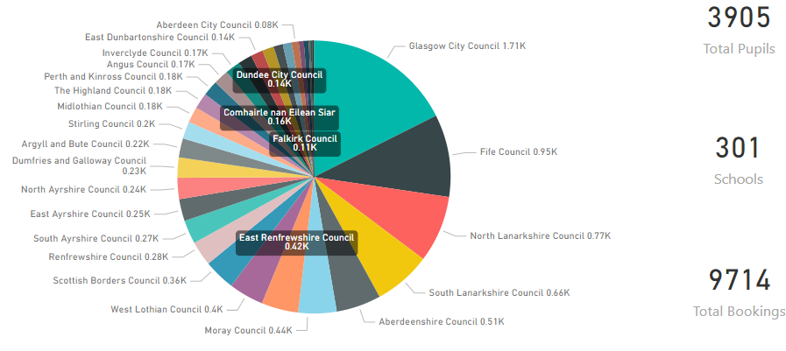
EEvening Webinars
Evening Study Support (available since 7th September 2020)
Course registrations by Senior Phase pupils:
​

Slide 5
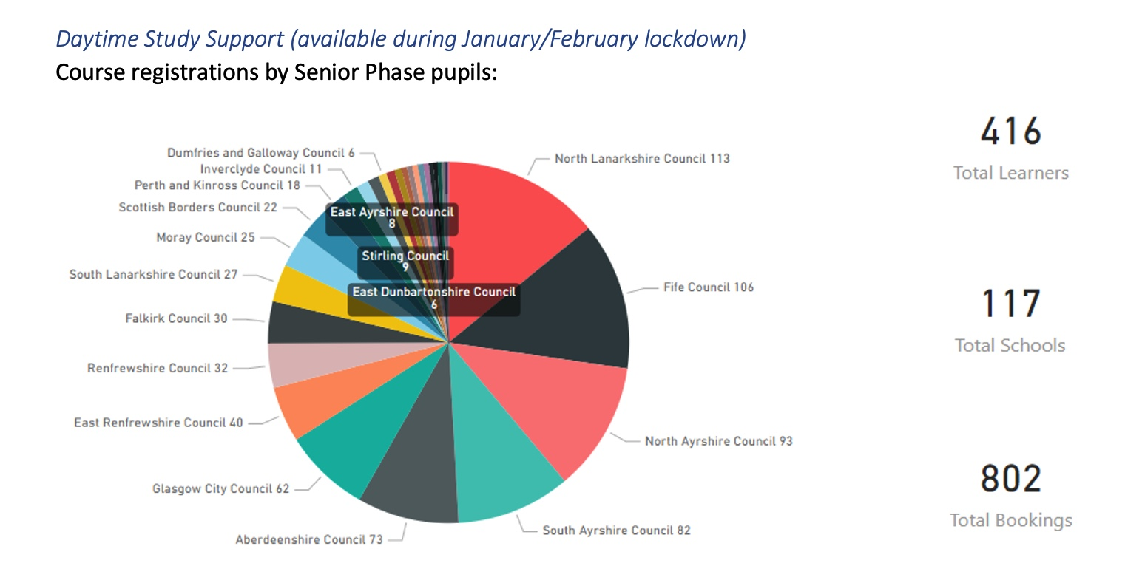
.Daytime Webinars
Daytime Webinars available since Jan 2021
Course registrations by Senior Phase pupils:
​

Slide 6
Webinars?
Webinar Style Delivery means…..
Webinars are designed to complement class teaching of a subject
Large groups of pupils (15-120)
Two teachers on most calls
Lead teacher delivers the ‘teaching’
Other teacher manages the chat
Flipped learning posted in chat before the session - mostly voice over PowerPoints
Legacy materials are ‘harvested’ by e-Sgoil
Shared with West OS and ES Supported Learning Space
​

Slide 7
.How do pupils join a webinar?
1. Go to e-Sgoil website http://www.e-sgoil.com/studysupport2020/
2. Have your glow id ready – this is essential for registering.
3. Press ‘Sign up here’.
4. Choose a webinar to attend.
5. Automated response from Team to Glow email
​

Slide 8
.What are our pupils telling us?
‘Life saver’ ‘Great teachers’
‘Very helpful’ ‘We want more’
Pupils rate the overall experience of the webinars at 4.6 out of 5
Numbers attending are staying high and more join all the time
Polls are regularly taken on what to study next
​

Slide 9
Next Steps:
Almost full coverage of subjects
and most levels
Run until June 2021 to offer
support where pupils need it
Easter Study School
60 courses with 3 live webinar inputs over the 2 weeks
Booking going live today – please promote!
Notes:
MM

Slide 10
Same but different
Good teaching is good teaching!
Planning is key
Chunk lessons
Work the room
Use non-verbal cues
Build in interactive forms & quizzes

Slide 11
Pupil voice
What makes for a good (online) lesson?
Being able to talk to each other
Being able to ask questions
Receiving instant responses from teachers
Learning interesting things
Doing interesting things
Clear instructions on what to do
Different parts to each lesson
Fun

Slide 12
Pupil voice
A good (online) teacher ….
is well prepared
is good at explaining things
is helpful
makes sure that that pupils understand
makes you want to learn
gives useful feedback
gives pupils the chance to ask questions
is patient
is understanding
is encouraging
is kind
is funny

Slide 13
Hints & Tips – General
Reduce workload
Work across departments/schools if possible
Plan
Organise
Label files & resources clearly preferably using a school wide convention
Beware!
Expect parents to be listening!
Chunk the sessions
Take a break!
Do not feel the need to perform at all times
Have a plan 'B'
Build in time away from the screen (for learner & teacher!)

Slide 14
Hints & Tips – IT
Flipped Learning
Keep it simple
Managing Behavior
Demonstration
Access a document camera
Creating Videos
Learn how to use Smart Recorder/other programme
Ensure that you know how to delete comments & set learner permissions

Slide 15
Safeguarding
It's all OK until it's not OK!
Anticipate issues & mitigate risk
Use a safe platform
Ensure learners are always supervised
Use background effects
Manage screen share permissions
Take care when using join codes
e-Sgoil Principals & Practice Document

Slide 16
Removing barriers

Slide 17
Donald A Macleod Principal Teacher, e-Sgoil damacleod1a@gnes.net Steven Graham Depute Head Teacher, e-Sgoil sgraham1g@gnes.net Twitter: @eSgoil www.e-sgoil.com
Notes:
MM

